Slide 1

Redesigning Economist Charts Activity
Notes:
Icon: chart by Setyo Ari Wibowo from the Noun Project

Slide 2
Redesigning Economist Charts
Group Activity Instructions
Split class into groups of 2-4 people
Each group will receive a chart
Answer the following questions about the chart:
What message is the chart trying to get across?
What is misleading about this chart or preventing the message from getting across?
With the above questions in mind, how would you redesign the chart? Sketch out or use your preferred visualization software to redesign the chart.
Share redesigns and discuss.
Notes:
[slide that you would show the class]

Slide 3
Redesigning Economist Charts
Group Activity Instructions (for instructor)
Split class into small groups (2-4 people)
Give each group an original chart from https://medium.economist.com/mistakes-weve-drawn-a-few-8cdd8a42d368
Ask each group to answer the following questions about the chart:
What message is the chart trying to get across?
What is misleading about this chart or preventing this message from getting across?
With the above questions in mind, how would you redesign the chart? Sketch out or use your preferred visualization software to redesign the chart.
If possible, pop into each group briefly to make sure they’re not overwhelmed/spiralling
Ask each group to share their redesign and show the better versions from the article.
Discuss the misleading and confusing elements and if the group found something different than the article. Great chance to talk about differences in perspectives and the many ways to visualize the same data.
If demonstrating a particular software, you could also demonstrate how to adjust scale and colors
Notes:
Possible concern is that students may not be as familiar with Western economics concepts like trade deficit, GDP, and surplus so maybe be prepared to provide some context if needed
Some interesting themes that might come up in discussion: who is the likely audience of this publication? What can they be expected to understand?
If these examples are not great for your audience, here are some other thoughts:
https://www.alteryx.com/input/coronavirus-data-visualizations-and-how-charts-lie
https://www.makeovermonday.co.uk/makeovers/
https://nsgrantham.shinyapps.io/tidytuesdayrocks/
Three levels of interpretation of the actual redesign:
What principles of “good design” / “bad design” do you see here? How do they change from initial design to redesign?
What do you think this redesign says about the context in which it was released (The Economist) and the intended audience? Why do you think this team made these decisions?
What ideas and assumptions are embedded in this redesign? What might the team have done differently (ie missed in the redesign) that could have helped the audience understand the ideas better?

Slide 4
What were the solutions from
The Economist?

Slide 5
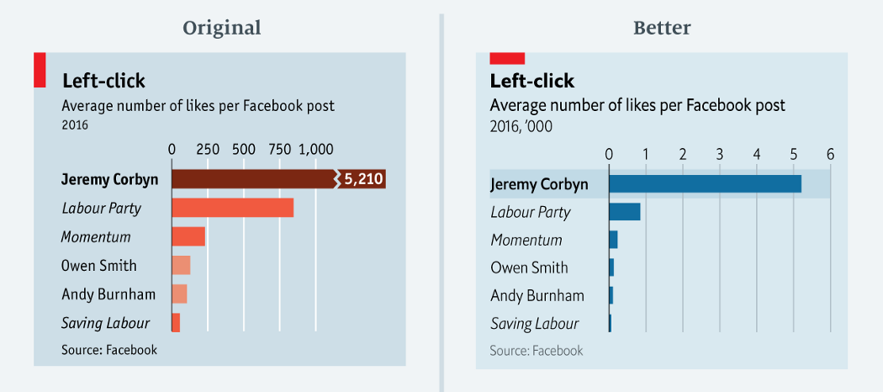
Left-click
https://medium.economist.com/mistakes-weve-drawn-a-few-8cdd8a42d368
Notes:
Message the chart is trying to get across: How far Jeremy Corbyn surpasses other British political parties and candidates in the number of Facebook likes.
What is misleading about this chart or preventing this message from getting across: The truncated scale.
Other improvements made to the chart: move to a single color for the bars
Other things to note: Potential confusion of thousands notation in better chart
Easy

Slide 6
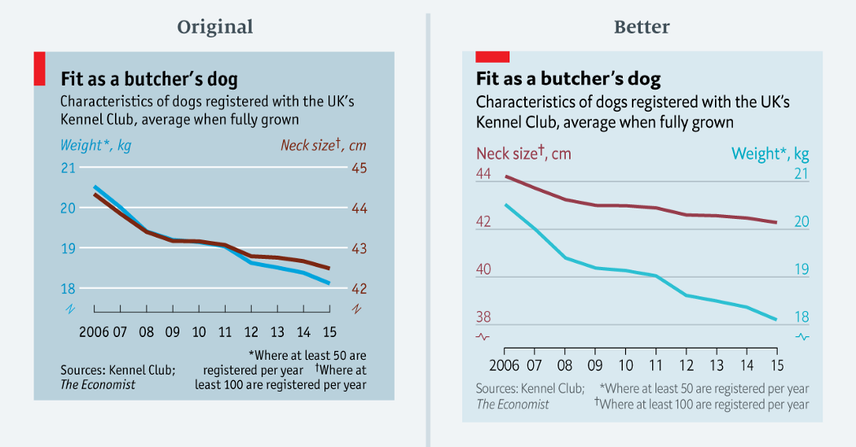
Fit as a butcher’s dog
https://medium.economist.com/mistakes-weve-drawn-a-few-8cdd8a42d368
Notes:
Message the chart is trying to get across: Neck size and weight dogs registered with the UK’s Kennel Club are decreasing at the same rate
What is misleading about this chart or preventing this message from getting across: Forced relationship by selecting scales. Issues of indexing, starting point of a scale.
Difficult
Note: this might be difficult to pick out. The way to see the difference is look at difference in percentage. Could be a class example with the whole class at the end (either work through whole thing as a big group discussion or present the before to everyone and have them break out again to brainstorm redesigns) or challenge question (try this in your small group if you finish early).

Slide 7
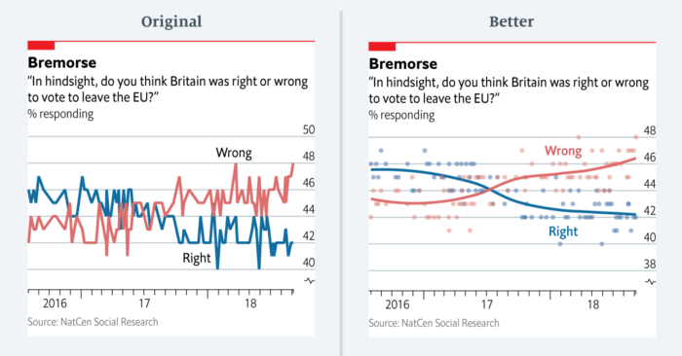
Bremorse
https://medium.economist.com/mistakes-weve-drawn-a-few-8cdd8a42d368
Notes:
Message this chart is trying to get across: Increasing number of respondents believe it was wrong for Britain to leave the EU, decreasing number of respondents believe it was right for Britain to leave the EU
What is misleading about this chart or preventing this message from getting across: Hard to see the general trend with the line chart type, overemphasizes the smaller fluctuations
Easy

Slide 8
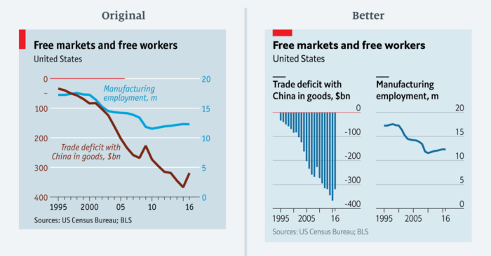
Free markets and free workers
https://medium.economist.com/mistakes-weve-drawn-a-few-8cdd8a42d368
Notes:
Message this chart is trying to get across: Relationship between trade deficit with China and manufacturing employment, trade deficit is increasing while manufacturing employment is decreasing
What is misleading about this chart or preventing this message from getting across: Difficult to read because left axis is negative and reads top to bottom, where the right axis reads from bottom to top
Hint for the group: look at the axes
Medium

Slide 9
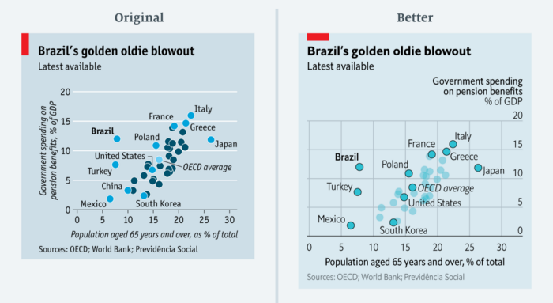
Brazil’s golden oldie blowout
https://medium.economist.com/mistakes-weve-drawn-a-few-8cdd8a42d368
Notes:
Message this chart is trying to get across: Brazil is paying a lot in pension considering it has a small portion of the population over 65, with other countries highlighted for comparison
What is misleading about this chart or preventing this message from getting across: color (specifically hue) implies there are different groups when there are no categories, multiple colors are distracting
Something to note: Inclusion of both gridlines to better highlight the intersection between the age and spending, why were these countries chosen to be labeled?
Easy

Slide 10
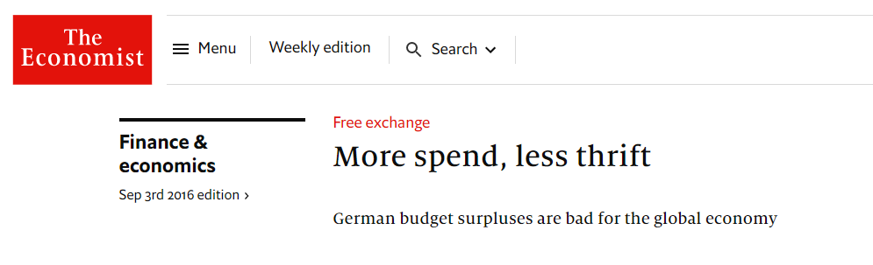
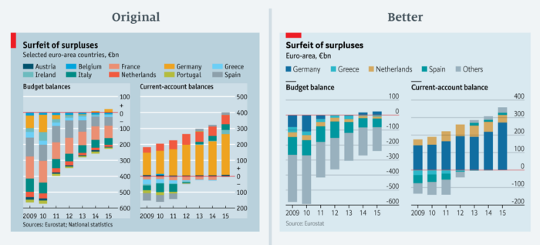
Germany compared to Greece, Netherlands, and Spain in the article
https://medium.economist.com/mistakes-weve-drawn-a-few-8cdd8a42d368
Notes:
Message this chart is trying to get across: Highlight the amount of surplus in Germany’s budget (very hard to get just by looking at the chart - better understanding of context based on article it appears in)
What is misleading about this chart or preventing this message from getting across: Too many colors, too many countries included (accompanying article only mentioned a few countries)
Note: probably should not be a stacked chart because positive and negative amounts not added together. Not sure if this is common in economics.
Might make more sense as a Fishbone diagram or waterfall chart
Medium (with article context) - easy fix for design, harder if you think about the numbers

Slide 11
Icon
chart by Setyo Ari Wibowo from the Noun Project

